Slide 1


Microprocessors and Assembly Language Spring 2020
Hamed Farbeh
farbeh@aut.ac.ir
Department of Computer Engineering
Amirkabir University of Technology
Lecture 10

Slide 2
Copyright Notice
Parts (text & figures) of this lecture are adopted from:
Atmel | SMART ARM-based MCU DATASHEET, SAM3X / SAM3A Series, Atmel-11057C-ATARM-SAM3X-SAM3A-Datasheet_23-Mar-15
Microprocessors and Assembly Language, Spring 2020, AUT, Tehran, Iran

Slide 3

Universal Synchronous Asynchronous Receiver/Transmitter (USART)
Microprocessors and Assembly Language, Spring 2020, AUT, Tehran, Iran

Slide 4
USART Characteristics
5- to 9-bit Full-duplex Synchronous or Asynchronous Communications
1, 1.5 or 2 Stop Bits in Asynchronous Mode
1 or 2 Stop Bits in Synchronous Mode
Configurable MSB- or LSB-first
By 8 or by 16 Over-sampling Receiver Frequency
Optional Hardware Handshaking RTS-CTS
RS485 with Driver Control Signal
SPI Mode
LIN Mode (USART0 only)
Ch. 35: Atmel | SMART ARM-based MCU DATASHEET, SAM3X / SAM3A Series, Atmel-11057C-ATARM-SAM3X-SAM3A-Datasheet_23-Mar-15
Microprocessors and Assembly Language, Spring 2020, AUT, Tehran, Iran

Slide 5
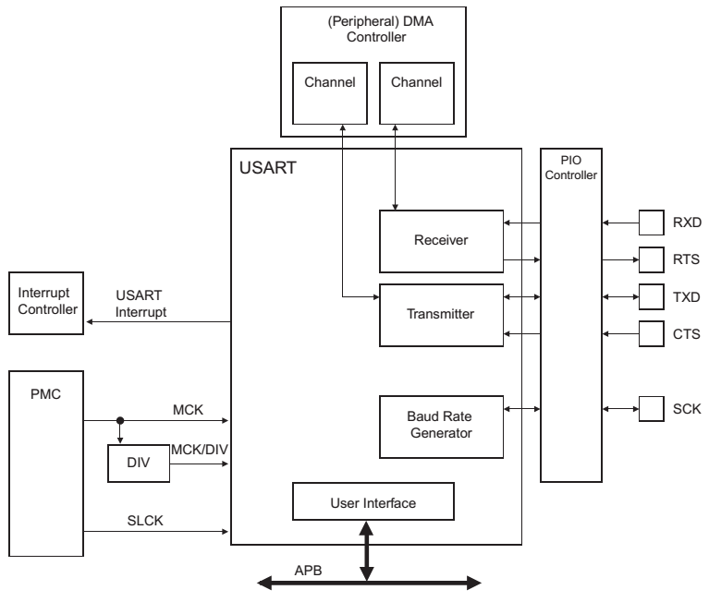
USART Block Diagram
Ch. 35: Atmel | SMART ARM-based MCU DATASHEET, SAM3X / SAM3A Series, Atmel-11057C-ATARM-SAM3X-SAM3A-Datasheet_23-Mar-15
Microprocessors and Assembly Language, Spring 2020, AUT, Tehran, Iran

Slide 6
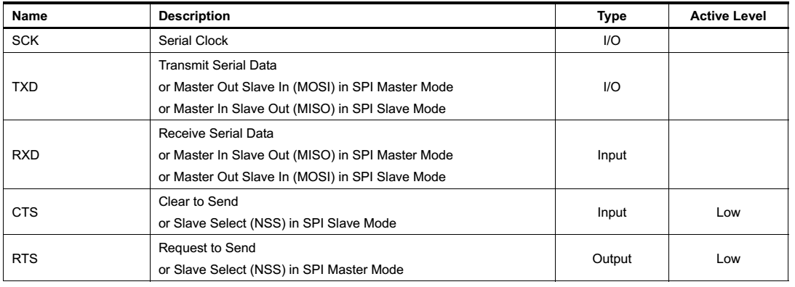
I/O Lines Description
Ch. 35: Atmel | SMART ARM-based MCU DATASHEET, SAM3X / SAM3A Series, Atmel-11057C-ATARM-SAM3X-SAM3A-Datasheet_23-Mar-15
Microprocessors and Assembly Language, Spring 2020, AUT, Tehran, Iran

Slide 7
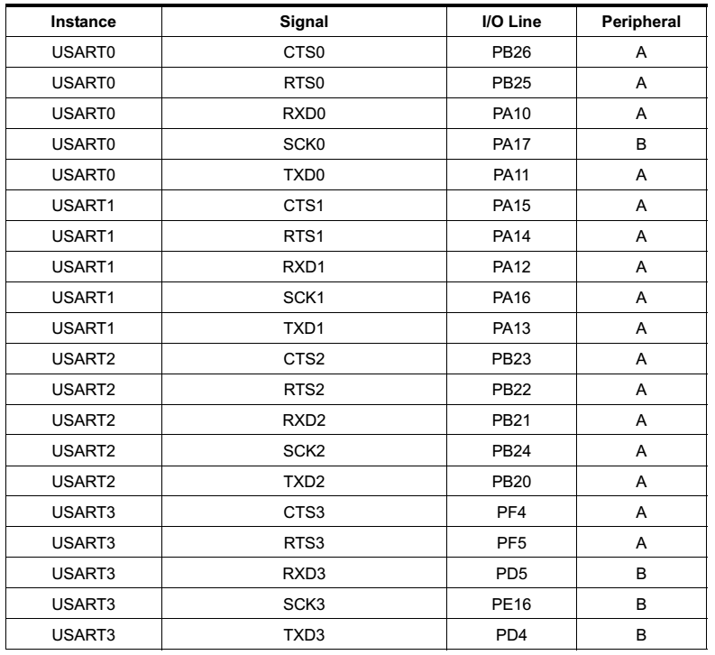
I/O Lines Description
Ch. 35: Atmel | SMART ARM-based MCU DATASHEET, SAM3X / SAM3A Series, Atmel-11057C-ATARM-SAM3X-SAM3A-Datasheet_23-Mar-15
Microprocessors and Assembly Language, Spring 2020, AUT, Tehran, Iran

Slide 8
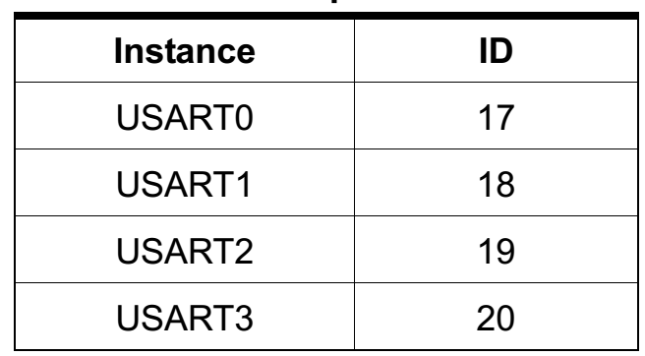
Interrupt Peripheral IDs
Ch. 35: Atmel | SMART ARM-based MCU DATASHEET, SAM3X / SAM3A Series, Atmel-11057C-ATARM-SAM3X-SAM3A-Datasheet_23-Mar-15
Microprocessors and Assembly Language, Spring 2020, AUT, Tehran, Iran

Slide 9
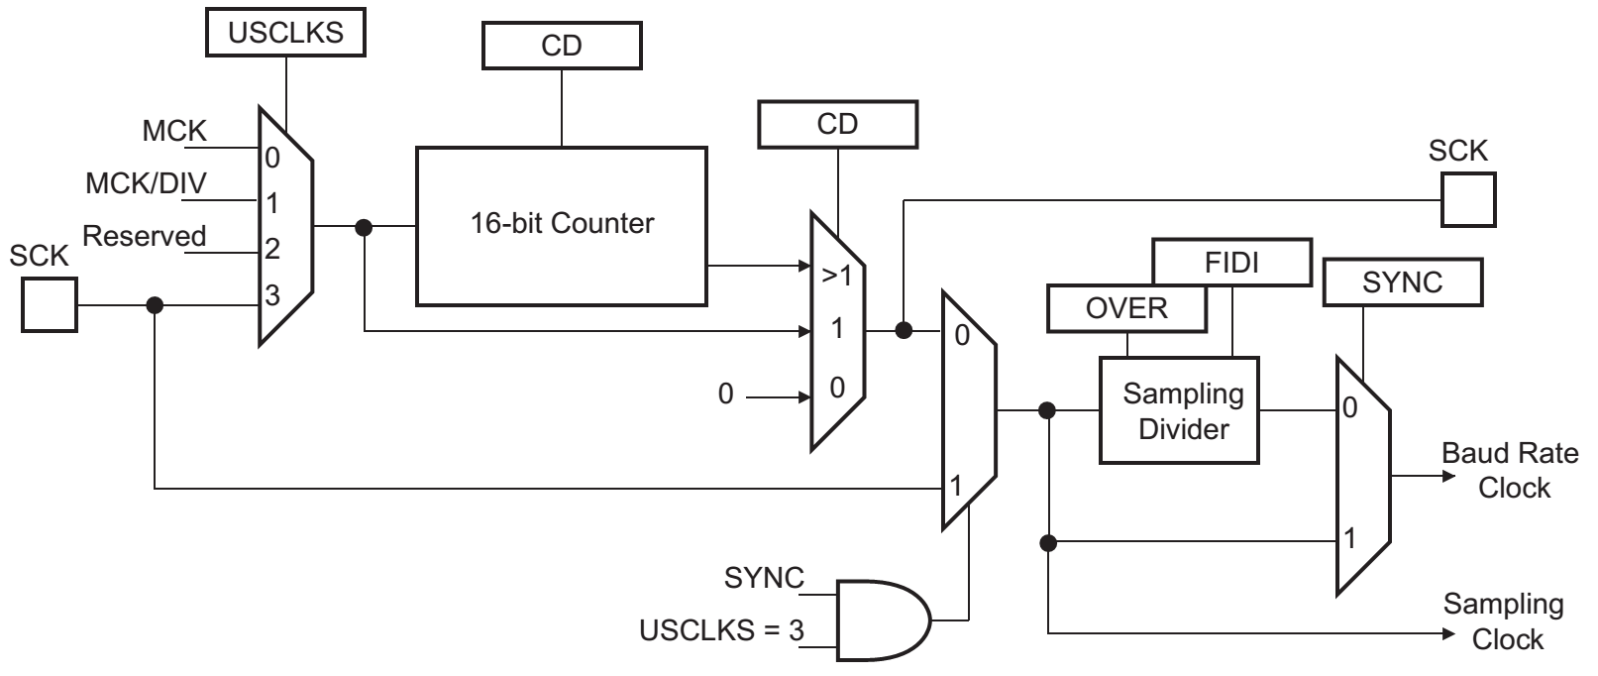
Baud Rate Generator
If selected, the frequency of the signal provided on SCK must be at least 3 times lower than MCK in USART mode, or 6 in SPI mode
Ch. 35: Atmel | SMART ARM-based MCU DATASHEET, SAM3X / SAM3A Series, Atmel-11057C-ATARM-SAM3X-SAM3A-Datasheet_23-Mar-15
Microprocessors and Assembly Language, Spring 2020, AUT, Tehran, Iran

Slide 10
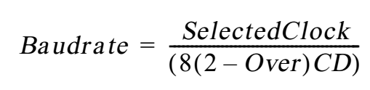
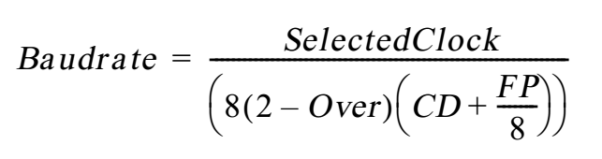
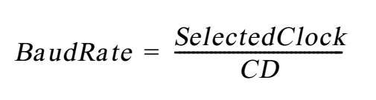
Baud Rate
Asynchronous Mode
Fractional Baud Rate: Program the FP field in the US_BRGR
Synchronous Mode
Ch. 35: Atmel | SMART ARM-based MCU DATASHEET, SAM3X / SAM3A Series, Atmel-11057C-ATARM-SAM3X-SAM3A-Datasheet_23-Mar-15
Microprocessors and Assembly Language, Spring 2020, AUT, Tehran, Iran

Slide 11
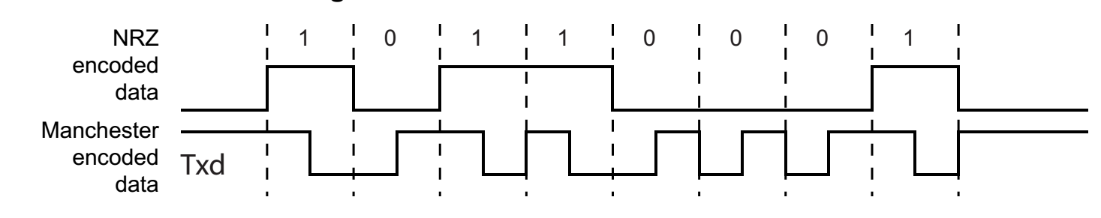
Data Transmission
The transmitter performs the same in synchronous and asynchronous modes
One start bit, up to 9 data bits, one optional parity bit and up to two stop bits are successively shifted out on the TXD pin at each falling edge of the programmed serial clock
Manchester mode
To enable this mode, MAN=1 field in the US_MR
Ch. 35: Atmel | SMART ARM-based MCU DATASHEET, SAM3X / SAM3A Series, Atmel-11057C-ATARM-SAM3X-SAM3A-Datasheet_23-Mar-15
Microprocessors and Assembly Language, Spring 2020, AUT, Tehran, Iran

Slide 12
Data Transmission
Asynchronous Receiver
Oversampling either 16 or 8 times the Baud Rate clock
Depending on the OVER bit in the US_MR
Synchronous Receiver
The receiver samples on each rising edge of the Baud Rate Clock
If a low level is detected, it is considered as a start
Synchronous mode operations provide a high speed transfer capability
Ch. 35: Atmel | SMART ARM-based MCU DATASHEET, SAM3X / SAM3A Series, Atmel-11057C-ATARM-SAM3X-SAM3A-Datasheet_23-Mar-15
Microprocessors and Assembly Language, Spring 2020, AUT, Tehran, Iran

Slide 13
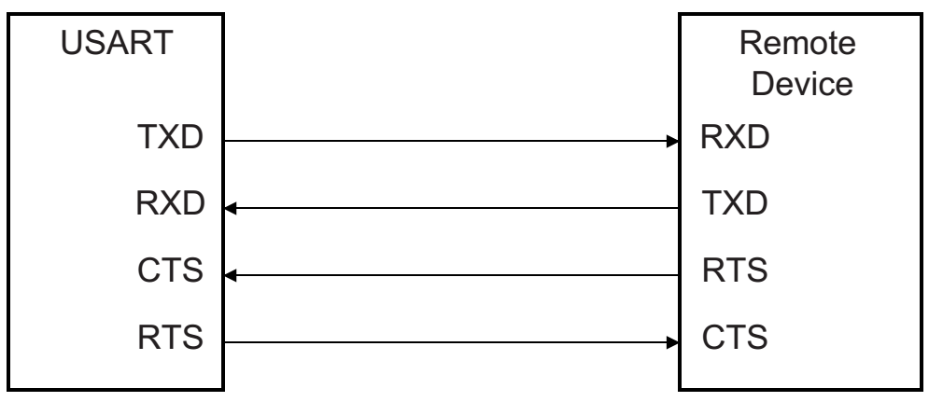
Hardware Handshaking
Receiver operation
The RTS (Request To Send) pin is driven high if
The receiver is disabled
The status RXBUFF (Receive Buffer Full) is high
The remote device does not start transmitting while its CTS pin (driven by RTS) is high
When the receiver is enabled, the RTS falls
Indicating to the remote device that it can start transmitting
Ch. 35: Atmel | SMART ARM-based MCU DATASHEET, SAM3X / SAM3A Series, Atmel-11057C-ATARM-SAM3X-SAM3A-Datasheet_23-Mar-15
Microprocessors and Assembly Language, Spring 2020, AUT, Tehran, Iran

Slide 14
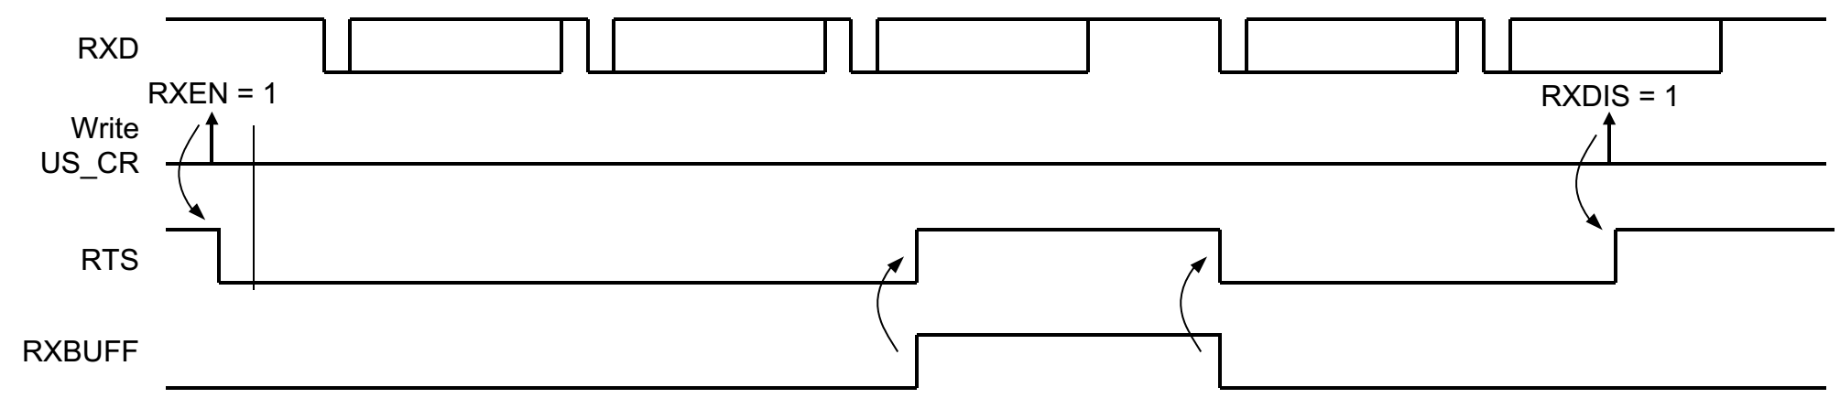
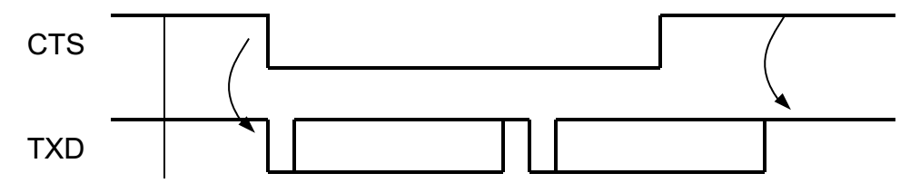
Hardware Handshaking
Ch. 35: Atmel | SMART ARM-based MCU DATASHEET, SAM3X / SAM3A Series, Atmel-11057C-ATARM-SAM3X-SAM3A-Datasheet_23-Mar-15
Microprocessors and Assembly Language, Spring 2020, AUT, Tehran, Iran

Slide 15
The End (for now)!
Microprocessors and Assembly Language, Spring 2020, AUT, Tehran, Iran

